Slide 1
ICT Project
Mario and Luigi Pizza

Slide 2
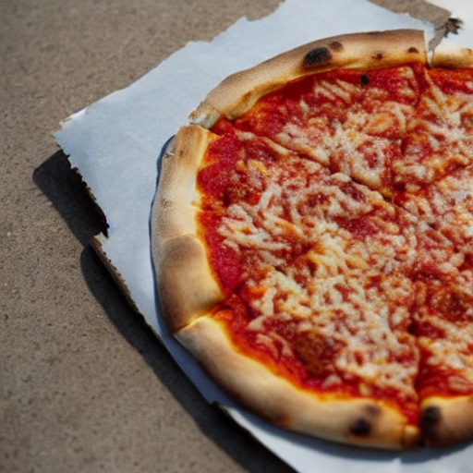
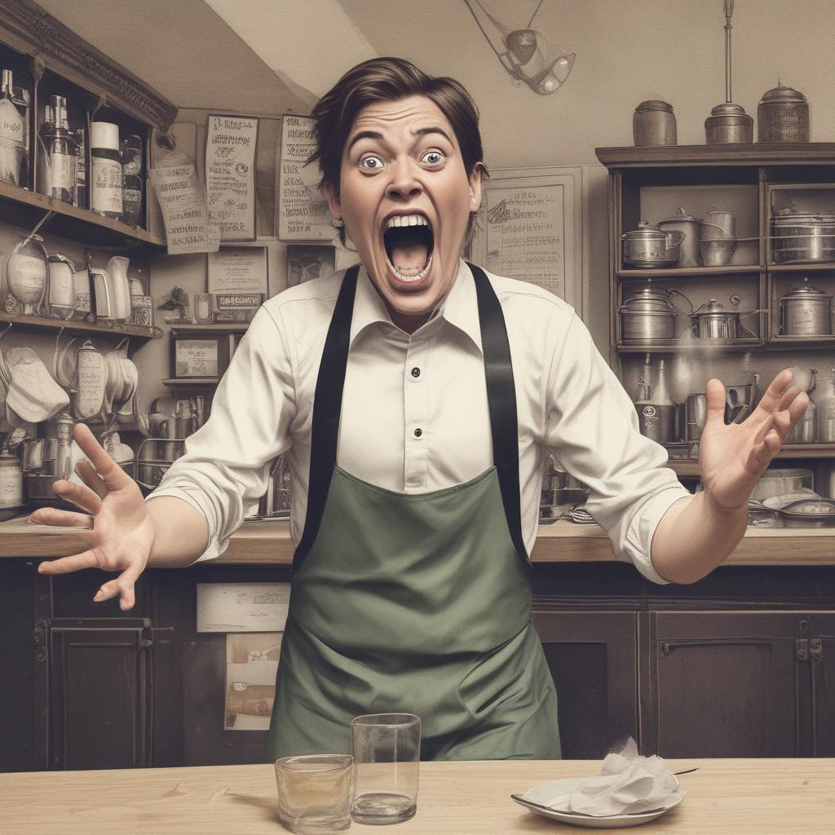
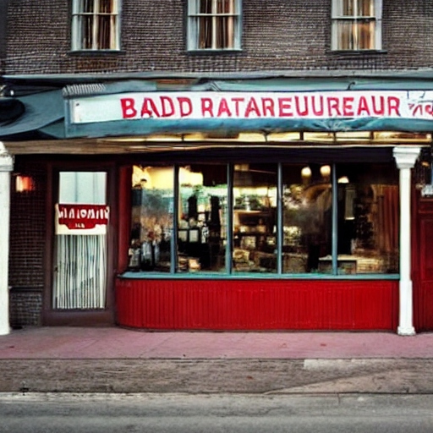
Problems
Cooking bad Pizza and putting wrong ingredient
High mess in the restaurant
Looks bad and old restaurant

Slide 3
Solutions and innovations

